Slide 1
SEED:A Framework for Extracting Social Events from Press News
Date: 2013/10/23
Author: Salvatore Oriando, Francesco
Pizzolon, Gabriele Tolomei
Source: WWW’13
Advisor: Jia-ling Koh
Speaker: Chen-Yu Huang

Slide 2
Outline
Introduction
SEED: social event discovery
Named Entity Recognizer
Relation Extractor
Experiment
Conclusion

Slide 3
Introduction
Propose a novel solution to a real problem raised up by a Web company, namely to detect structured information about social events from unstructured press news.
person : Larry Page, Sergey Brin
company : Google Inc
place : Palo Alto, California

Slide 4
Introduction
Consider two tasks:
Named-entity recognition(NER) : extract and classify entities from unstructured text
Relation extraction (RE) : to identify relations between entities.
SEED : social entertainment event detection
It turns out to detecting the following classes of entities from press news: DATE, LOCATOIN, PLACE, ARTIST.

Slide 5
Outline
Introduction
SEED: social event discovery
Named Entity Recognizer
Relation Extractor
Experiment
Conclusion

Slide 6
Definition
class :
abstract
entity:
concrete class
mention:
instance of a concrete class
EX:
mention(m): Google Inc, Big G
entity (e): Google
class(c): COMPANY

Slide 7
Definition
function :
Text document:
Named-entity:

Slide 8
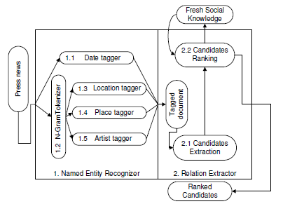
SEED : social event discovery
SEED : social entertainment event detection

Slide 9
Named entity recognizer
C = { DATE, LOCATION, PLACE, ARTIST }
Rule-based approach : regular expressions
Date tagger (ex: DD-MM-YYYY)
Knowledge-based : dictionary
N-Gram tokenizer : n consecutive words( n = 1…8)
Location tagger : cities, districts, and municipalities in Italy from
wikipedia
Place tagger : company’s database of place
Artist tagger : well-known artist from wikipedia

Slide 10
Relation extractor
Relations may span over multiple sentences and even across several press news
Achieve the relations by exploiting the so-called “wisdom of the crowd”.
Social Web source : social networks, blogs, wiki, search engines

Slide 11
Relation extractor
Candidate Extractor
generate a set of candidate 3-ary tuples
Candidate Ranking
Select the final set of 3-ary tuples to refer to actual events
An external Fresh Social Knowledge (FSK) module is used to rank candidate events

Slide 12
Candidate Ranking
Three external source
Encyclopedic knowledge : Wikipedia
drawback : a fact or an event has already happened
Social networks : Facebook
drawback: the only field indexed on such event table, is just a free-text field
Web search engines : Google
Given a user query, a search engine returns a ranked list

Slide 13
Candidate Ranking
Web search engines : Google
Candidate event t = (a, lp, d)
Query qt : the concatenation of the mentions corresponding to the entities of the tuple itself
Ranked list :

Slide 14
Candidate Ranking
Relevance score
rank
ftit(e, r):frequency counts of the mentions of entity e in the title
fsni(e, r):frequency counts of the mentions of entity e in the snippet
α, β:weights
γ (r):a score assigned to each web result
Linear SEED: γ (r)=1
Nonlinear SEED:γ (r) = 1 / rank(r)
S(t1)=0.9
S(t2)=0.1
S(t3)=0.6
T’D={t1, t3, t2}

Slide 15
Candidate Ranking
EX:
Query: Larry Page Google Inc Big G Palo Alto
R1:
Title:Larry Page(1) Google Inc /Big G(3) Palo Alto(1)
Entity:Larry Page(3) Google Inc /Big G(10) Palo Alto(3)
R2:
Title:Larry Page(1) Google Inc /Big G(1) Palo Alto(1)
Entity:Larry Page(3) Google Inc /Big G(5) Palo Alto(1)
S(t) = 1/1[α*(1*3*1)+β(3*10*3)]+1/2[α*(1*1*1)+β(3*5*1)]

Slide 16
Outline
Introduction
SEED: social event discovery
Named Entity Recognizer
Relation Extractor
Experiment
Conclusion

Slide 17
Experiments
Manually-labeled news
100 real Italian press news
1222 entities
198 events(relations)

Slide 18
Experiments
Result
Baseline 1 : the tuple in the same sentence of a press new
Baseline 2 : the frequency of tuple is higher than the others

Slide 19
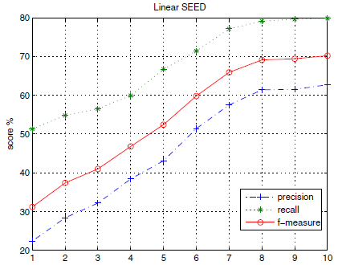
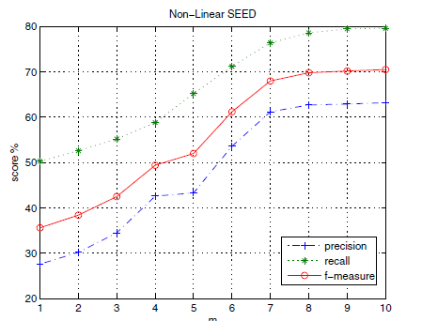
Experiments
α & β

Slide 20
Outline
Introduction
SEED: social event discovery
Named Entity Recognizer
Relation Extractor
Experiment
Conclusion

Slide 21
Conclusion
Proposed SEED, a framework to automatically discovery social events from a collection of unstructured press news.
SEED infers and disambiguates relations between previously discovered entities by exploiting the so-called “wisdom of the crowd”.
Possible future works are interested in exploring concern designing a more effective NER solution and exploiting other social media to improve the performance of the RE task.

